Slide 1

National Institute of Technology Puducherry
(An Institute of National Importance under MoE, Govt. of India)
Department of Computer Science and Engineering
IP1402- PROJECT III
First Review
12/02/2026
AI-based Automatic Road Network Extraction from Satellite Imagery
Presented By:
Aditya Ranganathan Arun (CS22B1002)
Annisha Rachel de Souza (CS22B1004)
Shivakumar B. (CS22B1052)
Guide:
Dr. Venkatesan M.
Associate Professor & HoD,
Department of CSE
National Institute of Technology Puducherry

Slide 2
Outline
Introduction
Motivation
Literature Survey
Gaps
Problem Statement
Objectives
Dataset
Methodology
Results(if any, in the form of graphs, charts, etc) & Analysis
Applications
References
Individual Contributions

Slide 3
Introduction
Road network extraction is a major requirement for policy-makers, urban planning, transportation management, and disaster response. With the increasing availability of high-resolution imagery from Indian remote sensing satellites, there is a growing need for automated methods that can reliably extract road networks at scale. Road extraction is formulated as a semantic segmentation problem, and a high-performance deep learning–based image recognition model is developed to delineate road surfaces from complex backgrounds.

Slide 4
Motivation
Accurate and up-to-date road network information is essential for urban planning, transportation management, disaster response, and policy-making. However, manual extraction and updating of road maps from satellite imagery is time-consuming, costly, and impractical for large and rapidly changing regions like India. The diversity of landscapes, varying road widths, occlusions from shadows and vegetation, and visually similar background features make automated extraction a challenging task for traditional methods. With the increasing availability of high-resolution remote sensing data, there is a strong need for robust and scalable automated solutions. Deep learning–based semantic segmentation provides the capability to learn complex and multi-scale features, enabling reliable and efficient extraction of road networks from complex environments.

Slide 5
Literature Survey
Article | Approach/Method | Advantages | Limitations | Remarks
Graph Residual U‑Net: Automated Deep Learning‑Based Road Extraction Using DeepGlobe Dataset, Cartosat‑2 and Sentinel‑2 Imagery International Journal of Innovative Research and Scientific Studies, Vol. 8, Issue 2, 2025, pp. 2047–2064. DOI: 10.53894/ijirss.v8i2.5634 Base Paper: No | Combines Residual U‑Net + Graph Neural Network (GraphSAGE) to capture spatial relationships and improve road connectivity in segmentation. Two models: Cartosat‑based & Sentinel‑2‑based. | Better feature extraction, preserves road connectivity, handles complex backgrounds, high accuracy, introduces new Sentinel‑2 labeled dataset. | Sentinel model has low precision/recall, graph layers increase computation, challenges remain with occlusions/shadows, limited labeled datasets. | Fills major research gaps (GNN + Cartosat/Sentinel). Strong architecture direction for future work. Shows promising results and good generalization.

Slide 6
Literature Survey
Article | Approach/Method | Advantages | Limitations | Remarks
Automated Road Extraction & Change Detection International Journal for Research Trends and Innovation (IJRTI), Vol. 10, Issue 9, September 2025. DOI: 10.12345/ijrti.v10i9.2509069 Base Paper: No | IoT + Android app + CNN + Decision Tree. ESP32‑CAM captures road images → uploaded to Firebase → CNN (TFLite) extracts roads & classifies quality → Decision Tree fuses metadata (traffic, usage, location) for final assessment. | Low‑cost IoT setup, real‑time monitoring, hybrid AI improves accuracy, cloud‑based storage, mobile‑friendly TFLite model, generates maintenance alerts. | CNN accuracy depends on dataset quality, limited robustness under shadows/occlusions, IoT hardware may face connectivity/power issues, Decision Tree relies on user‑entered metadata. | Practical smart‑city solution; strong integration of IoT + AI; scalable for government use; future scope includes transformers, more sensors, drone imagery, and edge deployment.

Slide 7
Literature Survey
Article | Approach/Method | Advantages | Limitations | Remarks
From Pixels to Progress: Generating Road Network from Satellite Imagery for Socioeconomic Insights in Impoverished Areas International Joint Conference on Artificial Intelligence June 2024 DOI: https://doi.org/10.1109/TGRS.2018.2870871 | The images are pre-processed using statistical methods such as Laplacian variance and mean normalization. Thes roads are segmented from these images using a road segmentation model CoANet followed by Morphological operation, Lastly a graph is extracted using a combustion algorithm. | The proposed method achieves much higher recall and F1 than baselines (RCFSNet, ViT, and OSM) and reconstructs about 80% of actual road length. It particularly improves the reconstruction of lower-class roads, which are critical in impoverished regions but often missing in OSM. | Provides relatively little systematic analysis of failure cases, such as: Very dense urban cores, extreme terrains, snow/seasonal effects, or unusual imaging conditions. | A practical, scalable pipeline for county-level road network extraction.

Slide 8
Literature Survey
Article | Approach/Method | Advantages | Limitations | Remarks
Combining Satellite Imagery and GPS Data for Road Extraction GeoAI@SIGSPATIAL November 2018 DOI: https://doi.org/10.1145/3281548.3281550 | The paper uses a modified U-Net semantic segmentation network that fuses satellite imagery and GPS data as multi-channel input. | The main conceptual strength is recognizing and exploiting the complementarity between satellite images and GPS traces. With a relatively small manually labeled dataset (120 images), the RGB-only model achieves modest mIoU, but fusing GPS channels boosts mIoU and F1 substantially. | Beyond comparing input combinations (RGB vs RGB+GPS variations), the paper does not explore alternative architectural designs | Provides a demonstration of multimodal fusion for road extraction, showing that relatively simple integration of GPS data into a CNN segmentation pipeline can substantially improve performance over satellite imagery or GPS alone.

Slide 9
Literature Survey
Article | Approach/Method | Advantages | Limitations | Remarks
Automated Road Extraction from Satellite Imagery Integrating Dense Depthwise Dilated Separable Spatial Pyramid Pooling with DeepLabV3+ | Replaces ASPP with Dense Depthwise Dilated Separable Spatial Pyramid Pooling (DenseDDSSPP) and integrates Squeeze-and-Excitation (SE) attention. | Better multi-scale feature detection and F1 score | Requires high computational resources for training and has a lower FPS for video segmentation. | Achieves state-of-the-art performance while improving efficiency.

Slide 10
Literature Survey
Article | Approach/Method | Advantages | Limitations | Remarks
Leveraging Transformer Architectures for Automated Building Detection in High-Resolution Satellite Images | Uses PVT(Pyramid Vision Transformer) as backbone with encoder-decoder architecture | Achieves high precision of 0.88 compared to 0.72 without the PVT backbone. | Due to a complex model it is not very suited for live segmentation | Achieves a high accuracy but has achieves poor throughput.

Slide 11
Gaps
No high-quality labeled dataset strategy – Problem mentions Cartosat/ Resourcesat data but lacks a clear plan for annotation, ground-truth creation, or leveraging OSM/MoRTH data.
Material classification underspecified – Lists example materials (bituminous, concrete, earthen) but no details on class definitions, validation methodology, or how to distinguish them from spectral/textural features.
No operational deployment strategy – Pipeline output and integration with Bhuvan/MoRTH systems, runtime efficiency on national-scale mosaics, and uncertainty estimation for downstream users are missing.
Generalization gap-does not discuss how to handle very different areas in India

Slide 12
Problem Statement
Extracting accurate road networks from high-resolution Indian satellite imagery is difficult due to complex urban layouts, occlusions, and terrain diversity, making manual mapping slow and error-prone. This work proposes an AI-based deep learning segmentation approach to automatically identify and generate reliable road network data for urban planning, navigation, and disaster management.

Slide 13
Objectives
To develop a deep learning segmentation model to accurately extract road interiors and boundaries from high‑resolution Cartosat and Resourcesat satellite imagery.
To convert segmented road masks into a topologically correct vector network that preserves geometric features (roundabouts, junctions) and removes noise.
To develop a frontend for the user interface to upload satellite streaming link.
To develop a fully automated pipeline suitable for integration with ISRO's geospatial platforms (Bhuvan) and government agencies (MoRTH, MoUHA).
To export traces to a trace parser to ensure low downtime.

Slide 14
Objectives
Objective 1: Develop a deep learning segmentation model to accurately extract road interiors and boundaries from high‑resolution Cartosat and Resourcesat satellite imagery.
Status: Yet to start

Slide 15
Objectives
Objective 2: Convert segmented road masks into a topologically correct vector network that preserves geometric features (roundabouts, junctions) and removes noise.
Status: Yet to start

Slide 16
Objectives
Objective 3: Develop a frontend for the user interface to upload the satellite streaming link.
Status: Yet to start

Slide 17
Objectives
Objective 4: Develop a fully automated pipeline suitable for integration with ISRO's geospatial platforms (Bhuvan) and government agencies (MoRTH, MoUHA).
Status: Yet to start

Slide 18
Objectives
Objective 5: To export traces to a trace parser to ensure low downtime.
Status: Yet to start

Slide 19
Dataset
DeepGlobe Road Extraction Dataset – High-res satellite images with road masks (622 training imgs)​
SpaceNet Road Network Dataset – Global high-res imagery + vector roads​
Massachusetts Road dataset
Sentinel-2 Roads Dataset (India) – 5634 patches from 7 Indian cities, OSM labels
https://bhoonidhi.nrsc.gov.in/bhoonidhi/index.html
https://bhuvan-app3.nrsc.gov.in/data/download/
ISRO RESPOND – Will provide IRS Cartosat/Resourcesat scenes for our project

Slide 20
Dataset
SN5: Automated Road Network Extraction and Route Travel Time Estimation from Satellite Imagery
The SpaceNet 5 challenge sought to build upon the advances from SpaceNet 3 and test challenge participants to automatically extract road networks and routing information from satellite imagery, along with travel time estimates along all roadways, thereby permitting true optimal routing.
The task of this challenge was to output a detailed graph structure with edges corresponding to roadways and nodes corresponding to intersections and end points, with estimates for route travel times on all detected edges

Slide 21
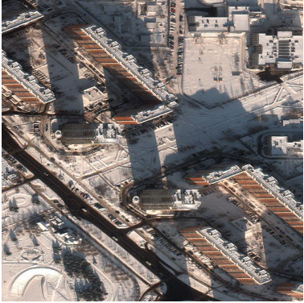
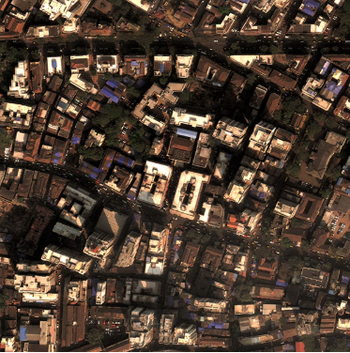
Dataset
SN5: Automated Road Network Extraction and Route Travel Time Estimation from Satellite Imagery

Slide 22
Dataset
SpaceNet 3: Road Network Detection
The commercialization of the geospatial industry has led to an explosive amount of data being collected to characterize our changing planet.
One area for innovation is the application of computer vision and deep learning to extract information from satellite imagery at scale. CosmiQ Works, Radiant Solutions and NVIDIA have partnered to release the SpaceNet data set to the public to enable developers and data scientists to work with this data.

Slide 23
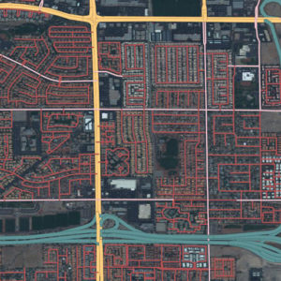
Dataset
SN5: Automated Road Network Extraction and Route Travel Time Estimation from Satellite Imagery

Slide 24
Dataset
Massachusetts Roads Dataset
The Massachusetts Roads Dataset consists of 1171 aerial images of the state of Massachusetts. Each image is 1500×1500 pixels in size, covering an area of 2.25 square kilometers.
We randomly split the data into a training set of 1108 images, a validation set of 14 images and a test set of 49 images. The dataset covers a wide variety of urban, suburban, and rural regions and covers an area of over 2600 square kilometers.
The test set alone covers over 110 square kilometers. The target maps were generated by rasterizing road centerlines obtained from the OpenStreetMap project. A line thickness of 7 pixels and no smoothing was used in generating the labels. All imagery is rescaled to a resolution of 1 pixel per square meter.

Slide 25
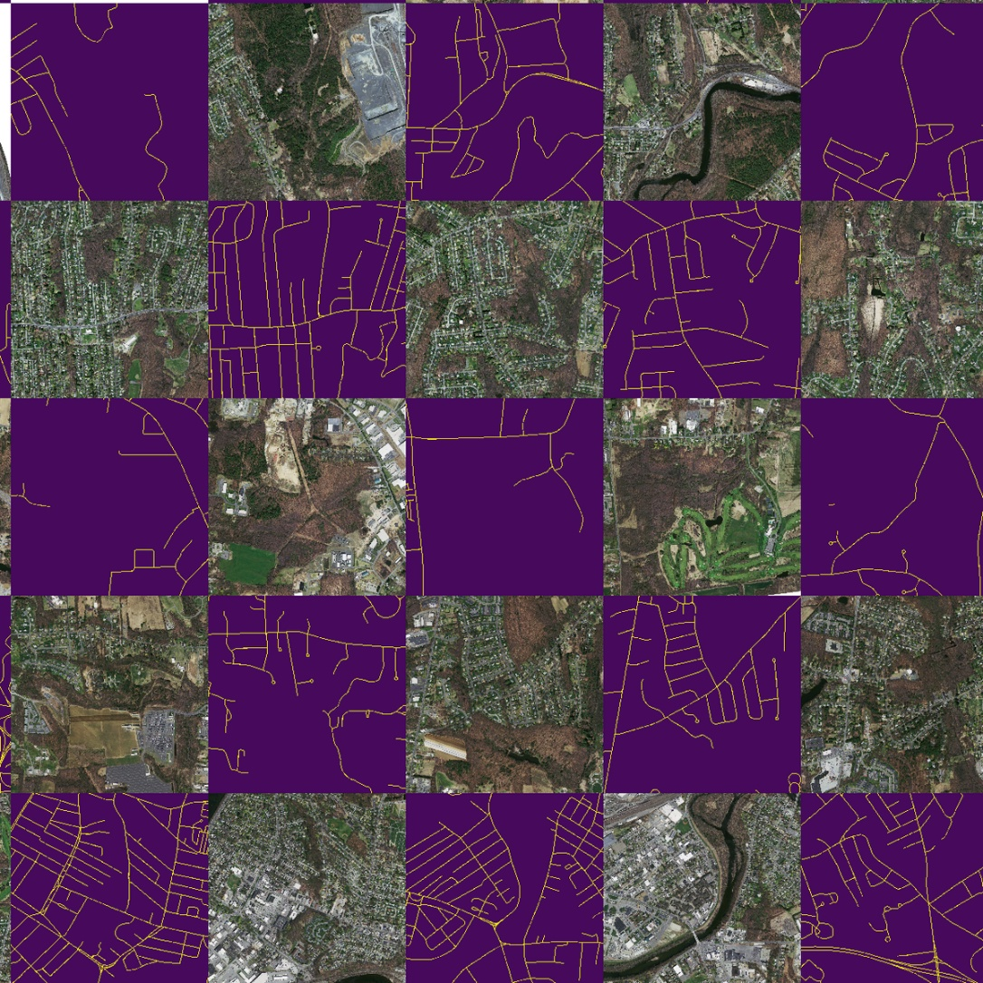
Dataset
SpaceNet 3: Road Network Detection

Slide 26
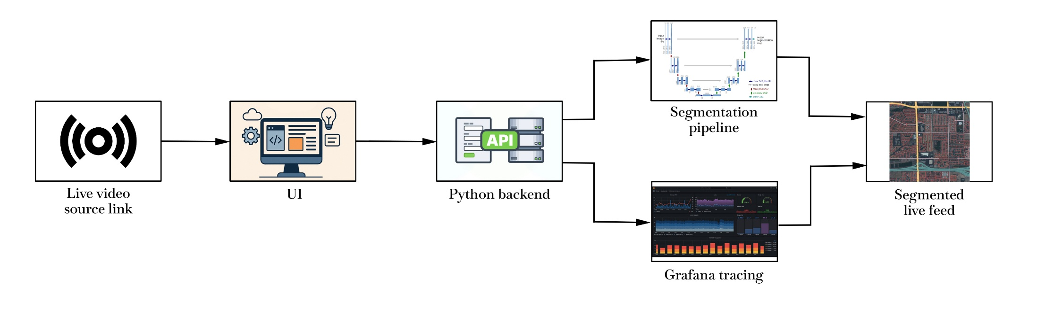
Methodology
Architecture

Slide 27
Applications
Road maintenance planning – Help MoRTH prioritize pothole repairs and upgrades using updated road maps from satellite data.
Rural road monitoring – Track new earthen/paved roads under PMGSY scheme across villages using periodic satellite scans.
Disaster response mapping – Identify accessible roads after floods/monsoons for relief operations in affected districts.
Urban navigation updates – Improve Google Maps/OpenStreetMap coverage in tier-2/3 cities with student-validated road networks.

Slide 28
References
[1]
[2]
[3] Mahara, A., Khan, M. R. K., Deng, L., Rishe, N., Wang, W., and Sadjadi, S. M., “Automated Road Extraction from Satellite Imagery Integrating Dense Depthwise Dilated Separable Spatial Pyramid Pooling with DeepLabV3+,” Applied Sciences, vol. 15, no. 3, p. 1027, Jan. 2025, doi: 10.3390/app15031027.
[4] T. P. Shinde, A. R. Mandale, A. U. Shinde, S. D. Shirtsath and S. T. Patil, “Automated Road Extraction & Change Detection,” International Journal for Research Trends and Innovation (IJRTI), vol. 10, no. 9, pp. a614–a618, Sep. 2025.
T. Sun, Z. Di, and Y. Wang, “Combining Satellite Imagery and GPS Data for Road Extraction,” in Proc. 2nd ACM SIGSPATIAL Int. Workshop on AI for Geographic Knowledge Discovery (GeoAI’18), Seattle, WA, USA, Nov. 2018, pp. 1–4, doi: 10.1145/3281548.3281550.
[5] Y. Xi, Y. Liu, Z. Liu, S. Tarkoma, P. Hui, and Y. Li, “From Pixels to Progress: Generating Road Network from Satellite Imagery for Socioeconomic Insights in Impoverished Areas,” arXiv preprint arXiv:2406.11282, 2024, doi: 10.48550/arXiv.2406.11282.
[6]

Slide 29
Thank You

Slide 30
Question & Answer

